Slide 1
Neural networks
Notes:
Let’s start this class in a way you might not expect a CS class to start: by thinking about a classic puzzle.

Slide 2
Announcements
Assignment 4 due Thursday
Assignment 5 due Tuesday 12/13
Final exam Monday 12/12

Slide 3
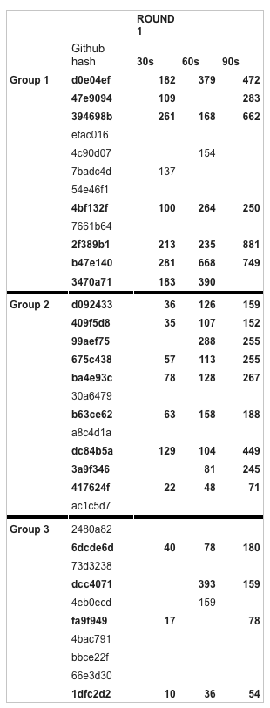
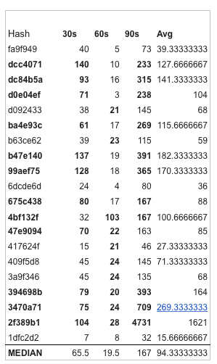
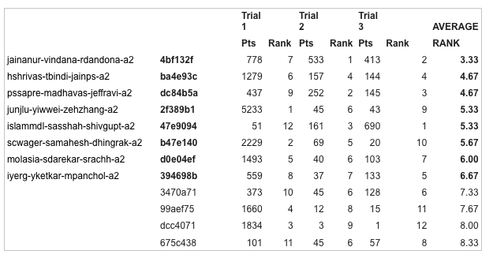

Slide 4
Perceptron
x₂
+
+
+
+
-
-
x₁
-
+
x₁
-
Σ
x_{i}
y
w₁ x₁ + w₂ x₂ = 0
w_{i}
-
g
g(u)
x_{n}
y = f(x,w) = g(Σ_{i=1,…,n} w_{i} x_{i})
u
Adapted from K. Hauser’s slide

Slide 5
Unit (Neuron)
x₁
Σ
x_{i}
w_{i}
y
g
x_{n}
y = g(Σ_{i=1,…,n} w_{i} x_{i})
g(u) = 1/[1 + exp(-au)]
Adapted from K. Hauser’s slide

Slide 6
Neural Network
Network of interconnected neurons
x₁
Σ
x_{i}
y
x₁
w_{i}
g
Σ
x_{n}
x_{i}
y
w_{i}
g
x_{n}
Acyclic (feed-forward) vs. recurrent networks
Adapted from K. Hauser’s slide

Slide 7
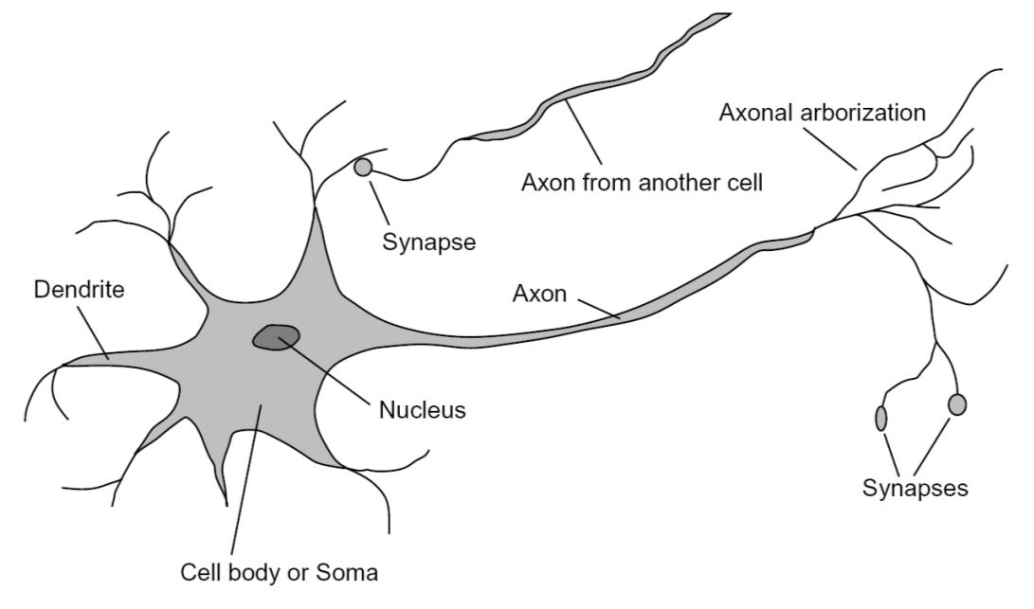
Inspiration: Neuron cells
Slide credit: Rob Fergus
Notes:
From Wikipedia: At the majority of synapses, signals are sent from the axon of one neuron to a dendrite of another... All neurons are electrically excitable, maintaining voltage gradients across their membranes… If the voltage changes by a large enough amount, an all-or-none electrochemical pulse called an action potential is generated, which travels rapidly along the cell's axon, and activates synaptic connections with other cells when it arrives.

Slide 8
Two-Layer Feed-Forward Neural Network
w_{1j}
w_{2k}
Inputs
Hidden
layer
Output
layer
Adapted from K. Hauser’s slide

Slide 9
Multi-Layer Generalization
Slide credit: T. Martinez

Slide 10
Slide credit: T. Martinez
Notes:
Still must be linearly separable (or close) at the top layer

Slide 11
Networks with hidden layers
Can represent XORs, other nonlinear functions
Many, many variants:
Different network structures
Different activation functions
Etc…
As the number of hidden units increases, the network’s capacity to learn more complicated functions also increases
How to train hidden layers?
Adapted from K. Hauser’s slide

Slide 12
Backpropagation Algorithm
Werbos, Rumelhart, Hinton, Williams (1974)
Until convergence:
Present a training pattern to network
Calculate the error of the output nodes
Calculate the error of the hidden nodes, based on the output node error which is propagated back
Continue back-propagating error until the input layer
Update all weights in the network

Slide 13
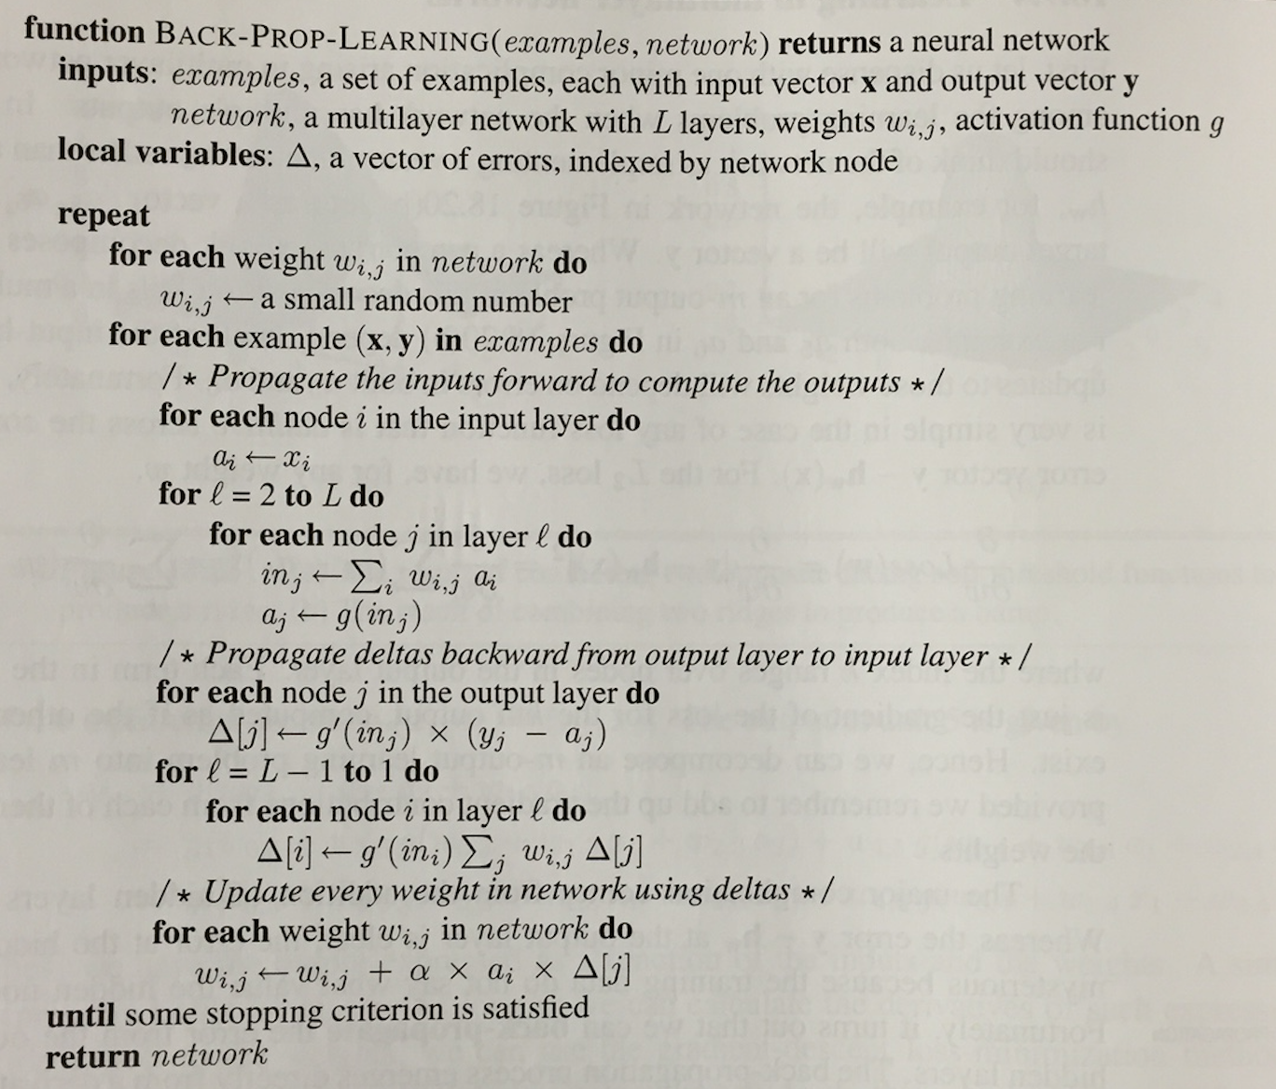

Slide 14
Understanding Backpropagation
Minimize E(θ)
Gradient Descent…
E(θ)
θ

Slide 15
Understanding Backpropagation
Minimize E(θ)
Gradient Descent…
E(θ)
Gradient of E
θ

Slide 16
Understanding Backpropagation
Minimize E(θ)
Gradient Descent…
E(θ)
Step ~ gradient
θ

Slide 17
Stochastic Gradient Descent
Classic backprop computes weight changes after scanning through the entire training set
Theoretically justified
But this is very slow
Stochastic gradient descent randomizes the input data, then takes a step after each training exemplar

Slide 18
Understanding Backpropagation
Example of Stochastic Gradient Descent
Decompose E(θ) = e₁(q)+e₂(q)+…+e_{N}(q)
Here e_{k} = (g(x^{(k)},θ)-y^{(k)})²
On each iteration take a step to reduce e_{k}
E(θ)
Gradient of e₁
θ

Slide 19
Understanding Backpropagation
Example of Stochastic Gradient Descent
Decompose E(θ) = e₁(q)+e₂(q)+…+e_{N}(q)
Here e_{k} = (g(x^{(k)},θ)-y^{(k)})²
On each iteration take a step to reduce e_{k}
E(θ)
Gradient of e₁
θ

Slide 20
Understanding Backpropagation
Example of Stochastic Gradient Descent
Decompose E(θ) = e₁(q)+e₂(q)+…+e_{N}(q)
Here e_{k} = (g(x^{(k)},θ)-y^{(k)})²
On each iteration take a step to reduce e_{k}
E(θ)
Gradient of e₂
θ

Slide 21
Understanding Backpropagation
Example of Stochastic Gradient Descent
Decompose E(θ) = e₁(q)+e₂(q)+…+e_{N}(q)
Here e_{k} = (g(x^{(k)},θ)-y^{(k)})²
On each iteration take a step to reduce e_{k}
E(θ)
Gradient of e₂
θ

Slide 22
Understanding Backpropagation
Example of Stochastic Gradient Descent
Decompose E(θ) = e₁(q)+e₂(q)+…+e_{N}(q)
Here e_{k} = (g(x^{(k)},θ)-y^{(k)})²
On each iteration take a step to reduce e_{k}
E(θ)
Gradient of e₃
θ

Slide 23
Understanding Backpropagation
Example of Stochastic Gradient Descent
Decompose E(θ) = e₁(q)+e₂(q)+…+e_{N}(q)
Here e_{k} = (g(x^{(k)},θ)-y^{(k)})²
On each iteration take a step to reduce e_{k}
E(θ)
Gradient of e₃
θ

Slide 24
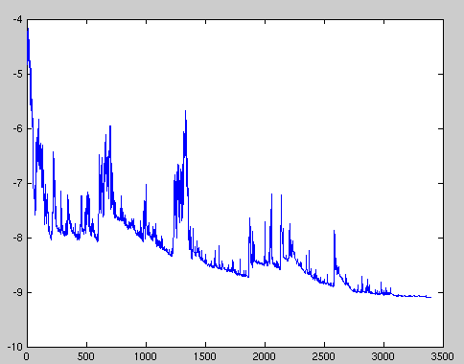
Stochastic Gradient Descent
Objective function values (measured over all examples) over time settle into local minimum
Step size must be reduced over time, e.g., O(1/t)

Slide 25
Caveats
Choosing a convergent “learning rate” α can be hard in practice
E(θ)
θ

Slide 26
Neural networks
Neural networks are universal function approximators
Given any function, and a complicated enough network, they can accurately model that function
How to choose the size and structure of networks?
If network is too large, risk of over-fitting (data caching)
If network is too small, representation may not be rich enough
Neural network

Slide 27
An aside: k nearest neighbor classifiers
Idea: nonparametric classifier – no model at all!
Simply store all of the training data.
To classify a new example:
Compare the new example to every training instance, find the closest according to a distance function
Assign the example to the training instance’s label
Done!
Generalization: Find k closest exemplars, then have them vote on the correct label.

Slide 28
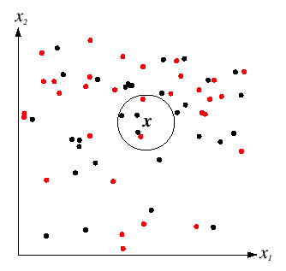
K nearest neighbors
k = 5
Source: D. Lowe

Slide 29
K nearest neighbors
Advantages:
Very simple. Very fast (trivial!) to train.
May work well given enough training data and good distance function
Disadvantages:
Need to choose distance function
Very sensitive to overfitting
Can be very slow and memory intensive

Slide 30
Summary of classifiers so far
Nearest neighbors
Can model any data, very prone to overfitting, requires distance function, fast learning, slow classification
Neural networks
Models any function, requires structure, can suffer from local minima, slow learning, fast classification, difficult to interpret.
Bayes nets
Requires setting network structure, fast learning, fast classification, intuitive interpretation of parameters.
Decision trees
Limited modeling power, mostly automatic, moderate learning speed, fast classification, intuitive interpretation of parameters.
Perceptrons
Very limited modeling power, fast training, fast classification, intuitive interpretation of parameters.

Slide 31
 | Modeling power? | Learning speed? | Classification speed?
K Nearest Neighbors | Any data | Fast
Neural nets | Any data | Slow
Bayes nets |  | Fast
Decision trees | Linear axis-oriented only | Moderate
Perceptrons | Linear only | Fast
Adaboost | Any data

Slide 32
Neural Nets: 1960s-1990s
Failure to deliver perceptron promises during during 1960s-1970s led to “AI winter”
In 1980s, multi-layer networks and the backpropagation algorithm led to new excitement, new era of neural network research

Slide 33
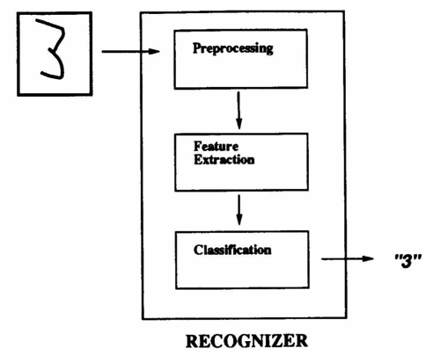
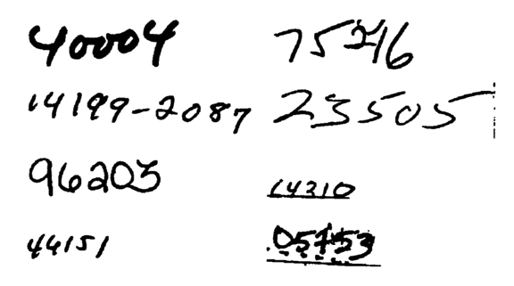
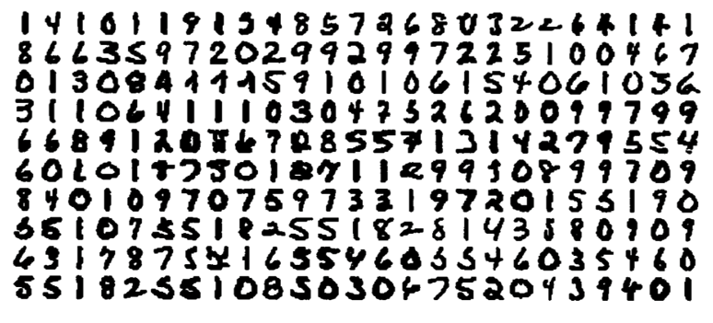
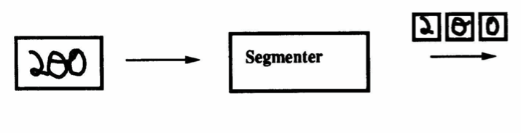
Success story: handwritten digit recognition (LeCun, 1989)

Slide 34
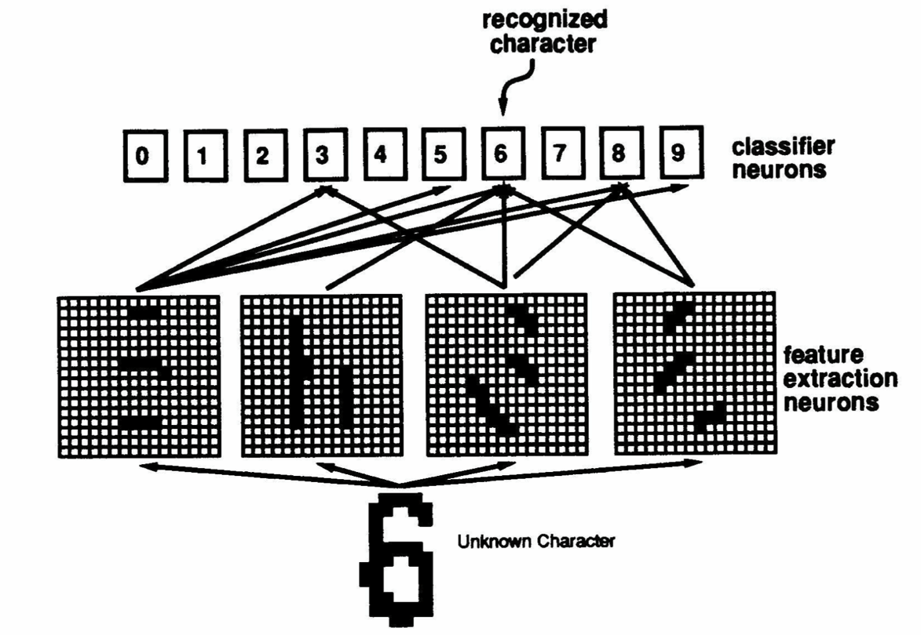
Network structure

Slide 35
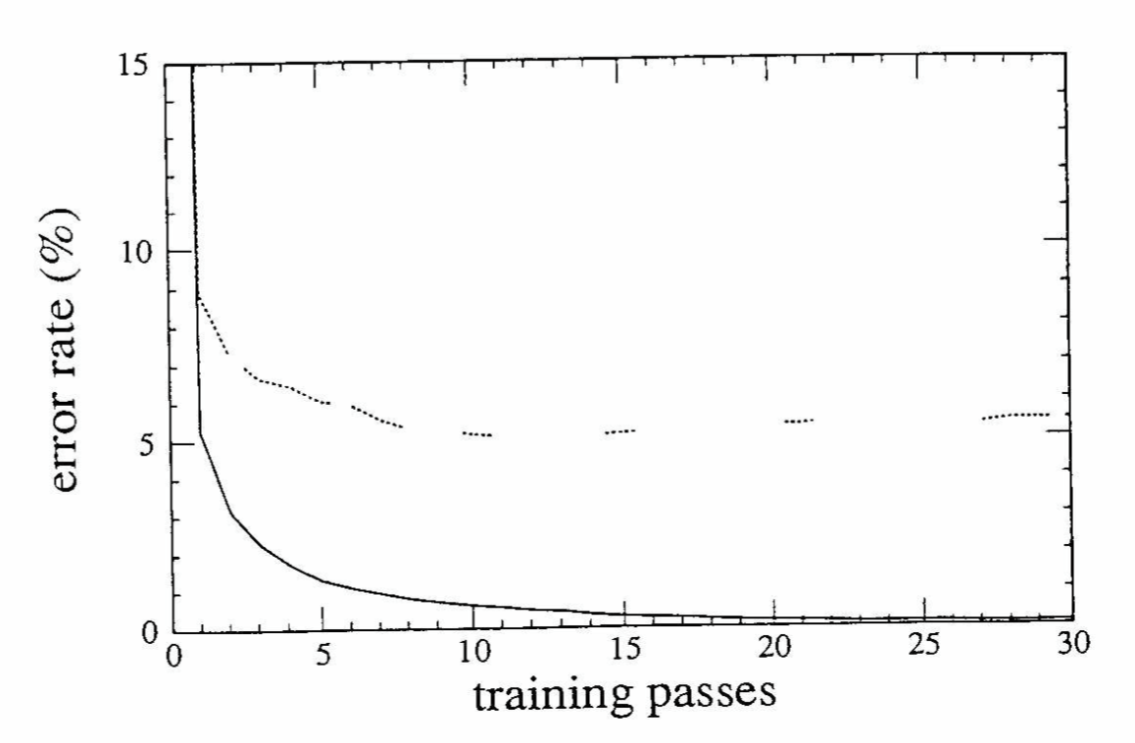
Use backprop to train

Slide 36
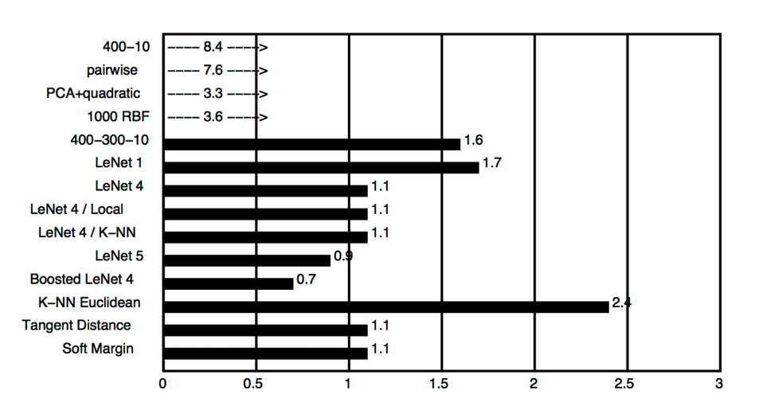
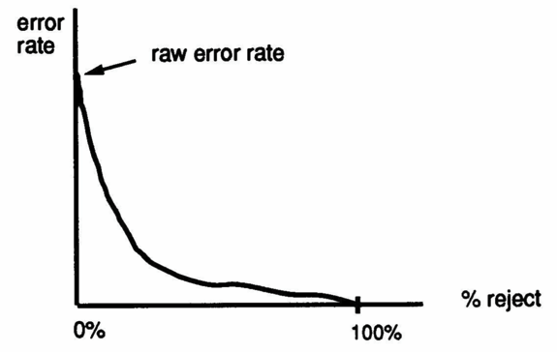
Worked better than other techniques (LeCun 1989)

Slide 37
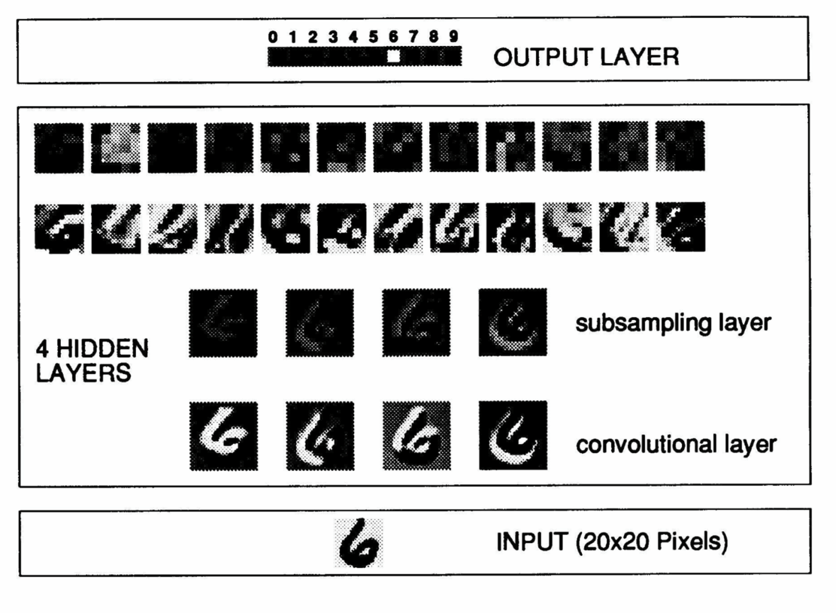
More complex architectures…

Slide 38
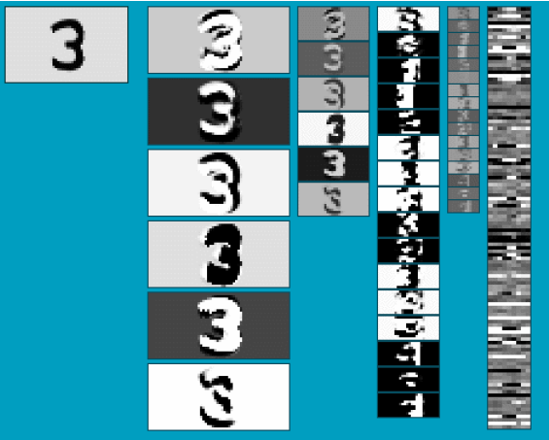
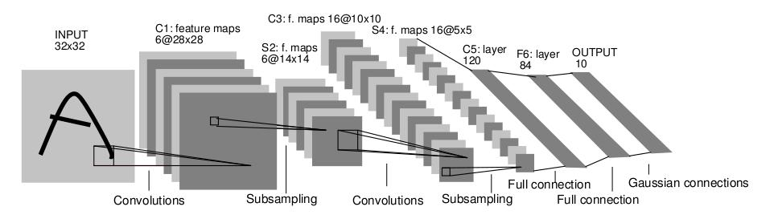
Convolutional Neural Networks
Neural network with specialized connectivity structure
Stack multiple stages of feature extractors
Higher stages compute more global, more invariant features
Classification layer at the end
Slide credit: Rob Fergus

Slide 39
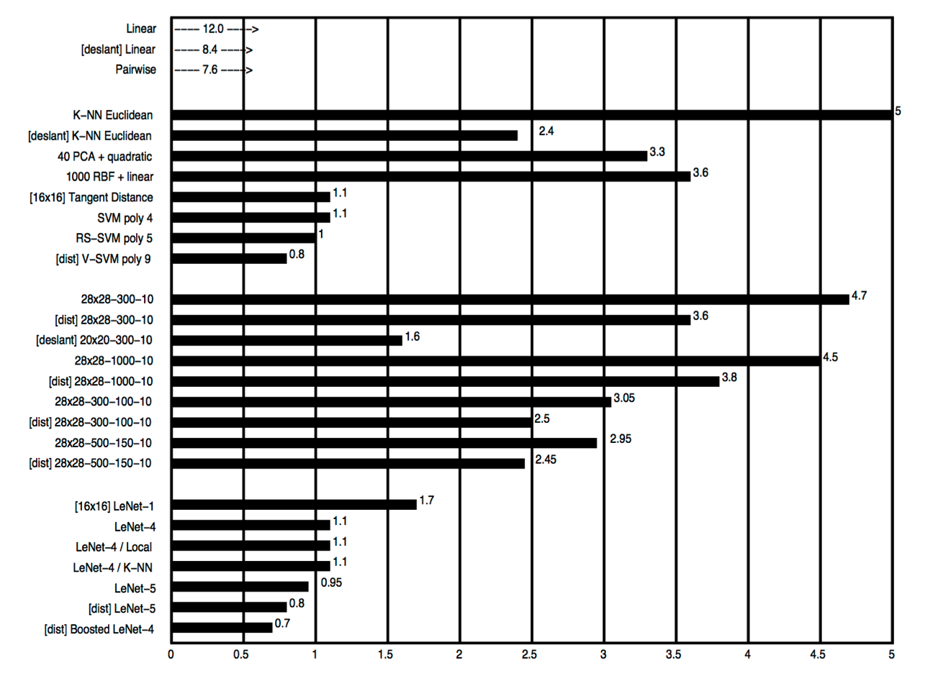
But other techniques catching up (LeCun 1998)

Slide 40
Late 1990s-2010: Another decline
Neural networks failed to work equally well on more complicated problems
E.g. recognition in real images, real audio streams, etc.
Mix of practical and theoretical problems
How to decide network structure and many learning parameters (e.g. step sizes)?
Required too much computation
Required too much data
Very difficult to “debug” failures

Slide 41
2000’s: Return to the simple
Return to simpler techniques, like linear classifiers
But in high dimensions
Simpler learning algorithms, easier to justify theoretically
Learn classifiers on manually-created features
E.g. not images themselves, but statistical features like color histograms, edge distributions, etc.

